Slide 1
IPI TAC - Jira Service Desk
Jira Service Desk Overview

Slide 2
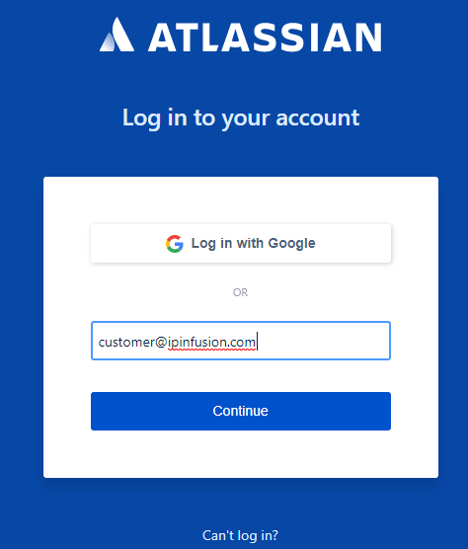
IP Infusion TAC Team – JSD Overview
Method to login Jira System :
Login with the email id and password
One login per customer is provided to access the portal. If access and notification to ticket updates is required for more than one user, then please share a mailing list from your organization with IPI Support team (e.g. ipi-support@<your-domain.com> etc.)
Link: https://ipinfusion.atlassian.net

Slide 3
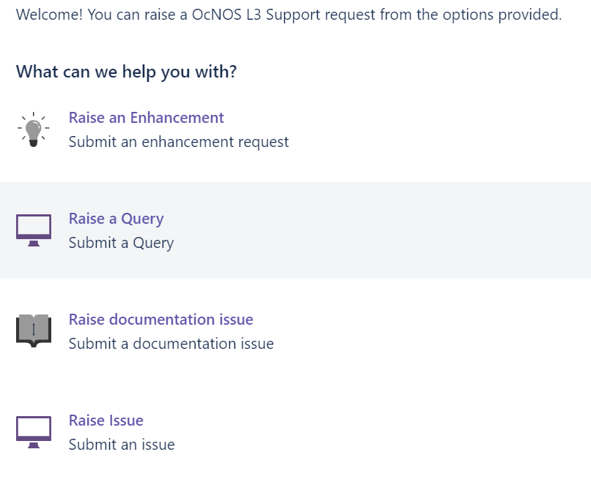
IP Infusion TAC Team – JSD Overview
JSD has an option to raise 4 different types of issues as shown below once you login
Raise an Enhancement
  Request related to new feature requirement.
  Feature is not supported by IPI, expecting in roadmap.
Raise an Query
  Request related to information about IPI Products.
Raise documentation Issue
  Request related to document related to IPI Product.
  Information required related Feature Matrix, Configuration guide, Release notes.
Raise Issue
  Request related to an issue related to IPI, which included Software, Hardware, Configuration support.
Select appropriate on issue reported

Slide 4
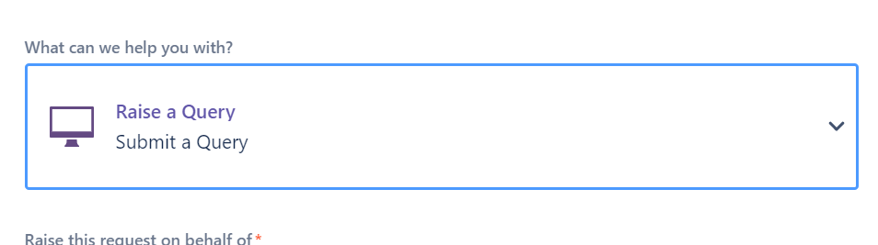
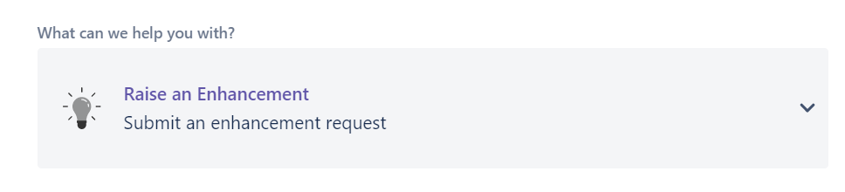
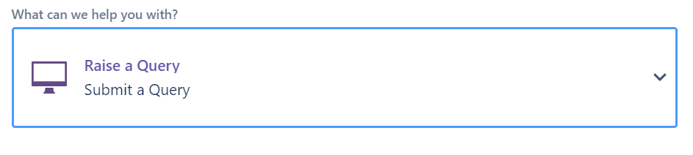
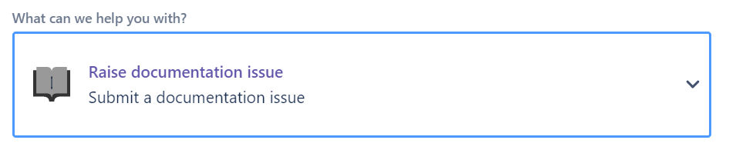
IP Infusion TAC Team – JSD Overview
Types of issues can be searched by typing name of issue type in search option too. For example
Select an option to raise ticket with IPI
Raise an Enhancement
Raise an Query
Raise documentation Issue
Raise Issue

Slide 5
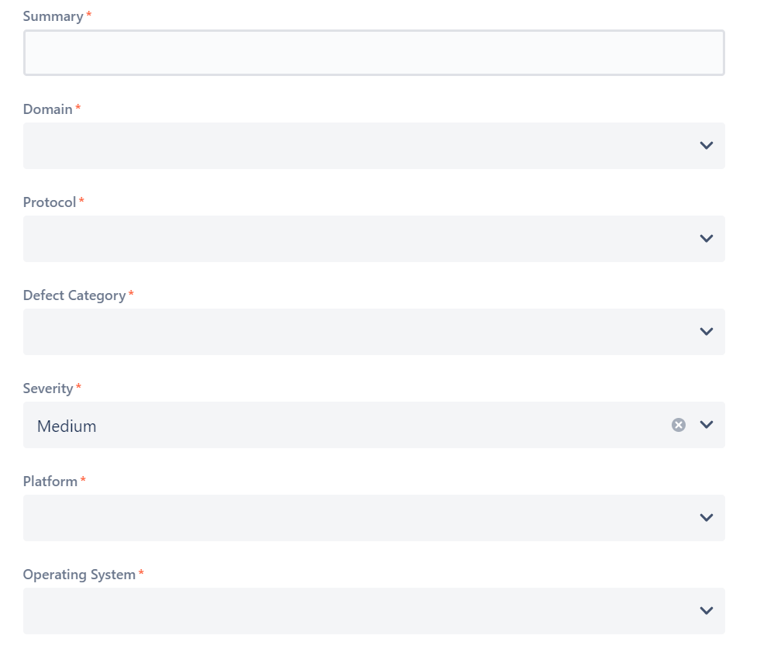
IP Infusion TAC Team – JSD Overview - Submit an Issue
Types of issues can be searched by typing name of issue type in search option too. For example
Fields are auto populated with dropdown selection :
Summary : Brief Description about Issue reported and IPI to isolate resolution.
Domain : Domain belongs to L3, Multicast, MPLS, etc..
Protocol : Protocol belongs to OSPF, BGP, etc..
Defect Category : Categorized related to Functionality, Interop, CLI etc.
Severity : Select severity based on service impact. (Based on Service Level Agreement provided by IPI).
Platform : Select platform based on requirement.
Operating System : Select Operating System.

Slide 6
IP Infusion TAC Team – JSD Overview - Submit an Issue
Types of issues can be searched by typing name of issue type in search option too. For example
Fields are auto populated with dropdown selection :
Summary : Brief Description about Issue reported and IPI to isolate resolution.
Domain : Domain belongs to L3, Multicast, MPLS, etc..
Protocol : Protocol belongs to OSPF, BGP, etc..
Defect Category : Categorized related to Functionality, Interop, CLI etc.
Severity : Select severity based on service impact. (Based on Service Level Agreement provided by IPI).
Platform : Select platform based on requirement.
Operating System : Select Operating System.

Slide 7
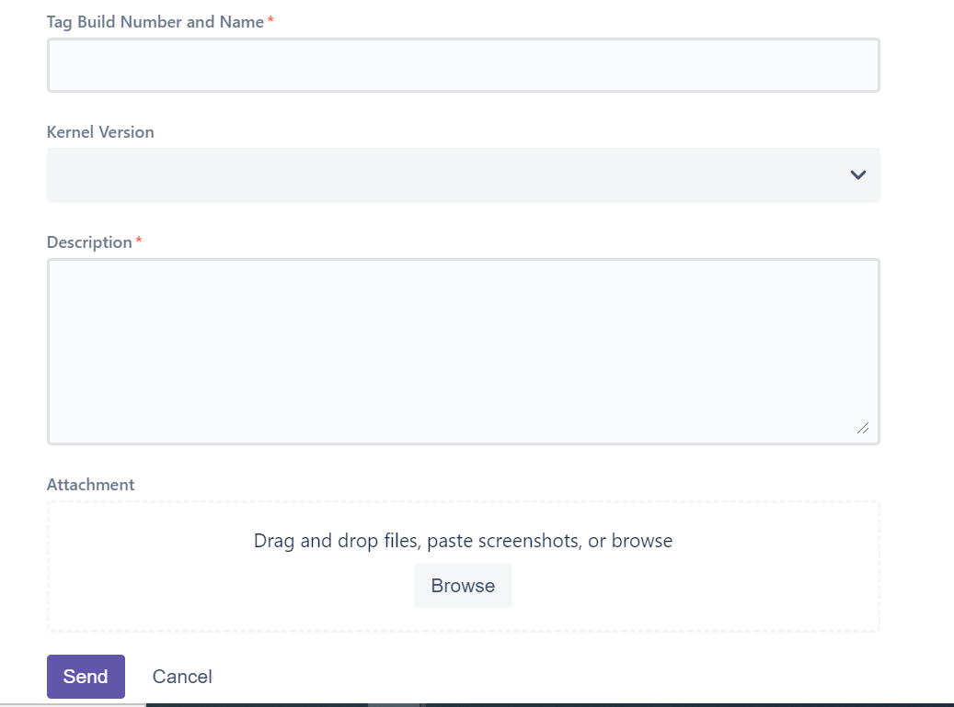
IP Infusion TAC Team – JSD Overview - Submit an Issue
Fields are auto populated with dropdown selection :
Tag Build Number and Name : Name and Build name available in Device – Show Info.
Kernel Version : Mention Kernel version running on the device.
Description : Please provide complete summary of issue description which includes, Topology, Configuration, Required supporting logs, full BT & Crash information.
Attachment : Attach any supporting logs required for the ticket.
Additional Information
  Customer : Name of the person raise ticket.
  Customer Mail ID : Email ID required for communication.
  Organization : Please mention Organization name.
  Select Send to Create Ticket.

Slide 8




IP Infusion TAC Team – JSD Overview - Ticket Status
The state of the ticket will be “waiting for support” after raising the issue which will be visible on right side.
The state will be changed to “Assigned” once IPI support team take the issue.
The state will be changed to “Open” once the assigned Engineer start working on the issue.
The state of the ticket will change to “waiting for customer” if any information is required from customer.

Slide 9



IP Infusion TAC Team – JSD Overview - Ticket Status
Customer have to click on the “Respond” after sharing the required details so that the ticket will again go back to Open state
The state of the ticket will change to “Defect raised” once the defect is raised by support team
The state of the ticket will change to “Need info from developer” in case if support team is checking with development team internally
The state of the ticket will change to “Waiting for vendor” in case of support team is waiting for any inputs from vendor for hardware/BCM related issue

Slide 10
IP Infusion TAC Team – JSD Overview - Ticket Status
Customer have to click on the “Respond” after sharing the required details so that the ticket will again go back to Open state
The state of the ticket will change to “Defect raised” once the defect is raised by support team
The state of the ticket will change to “Need info from developer” in case if support team is checking with development team internally
The state of the ticket will change to “Waiting for vendor” in case of support team is waiting for any inputs from vendor for hardware/BCM related issue

Slide 11
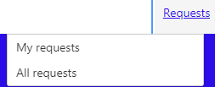
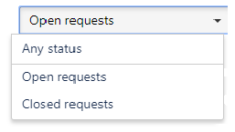
IP Infusion TAC Team – JSD Overview - Ticket Status
My requests option available at the top right end corner to get information of the tickets raised by the customer.
By default customer will get to see about the “Open requests” by default immediately after selecting “My requests”
We can select required type of issue that we are trying to search by selecting corresponding option from dropdown menu. Any requests: Shows list of all tickets raised Open requests: Shows list of tickets which are open to be fixed Closed requests: Shows list of tickets which are fixed

Slide 12
IP Infusion TAC Team – JSD Overview - Ticket Status
Can write required string to be searched in the space provided for Search option (“Request contains” field)
Can select the particular dropdown option like Any requests, Open requests, Closed requests to search in specific list of requests
Click on search to search for specific string & in specific list of requests
Note: Search is based on the summary of the ticket
Differentiating tickets based on the ticket owner
While raising ticket user can include his/her name at the beginning followed by summary of the issue like Usr1: BGP session not coming up Usr1: OSPF crashed Usr2: CLI not working
So when customer want to get list of tickets of Usr1 then customer can search by Usr1 similarly Usr2 etc

